Slide 1
Cognet Git workshop

Slide 2
About me
Name: Jesper Strøm
My background:
Bachelor in Software Engineering
App developer at Aeroguest
Master in Computer Technology
Currently
PhD student at Center for Ear-EEG, AU
Writing all my code in Python
Using Git (almost) every single day

Slide 3
Agenda
Version control, Git and Git repositories
Basic Git workflow
Workshop 1
Branches & merges
Workshop 2
The .gitignore file
Workshop 3

Slide 4
WHy version control?
Scenarios
Reverting changes
Creating alternative versions of the code
Tracking our progress
Share our code with others
Collaborate with others
V2.1a
V2.2.a
V2.0a
V1.0
V1.1
V2.0c
V2.1c
V2.0b
V2.1b
V2.2b

Slide 5
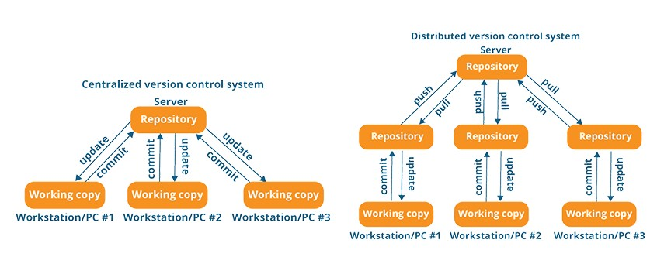
Centralized vs. distributed
Key idea:
Each computer has a local ”repository”
We synchronize the remote and local repository when we want
https://www.thatcompany.com/do-you-need-a-version-control-system

Slide 6
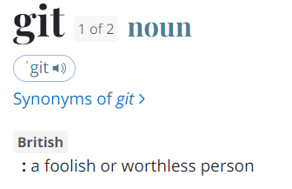
What is Git?
Made by Linus Torvalds, who is also know for creating Linux
It is a distributed version control system
Usually used for code, but we can version control (almost) anything
Git can be used as a command-line tool or user-interface
Learning to use the command-line first will improve understanding
Git has way too many features for one workshop, so i will teach the basics

Slide 7




Git, Github, Gitlab, BitbuckeT
Git is a program
Github, Gitlab and Bitbucket are online services to use with git repositories
Different services, same interface
Github
Gitlab
Bitbucket
git
git
git

Slide 8
What is a Git repository?
A Git repository is a collection of files marked for version control by Git
As seen by the ”.git” folder inside the project
This folder contains (among other things) the history of the repository
A repository can be located on a local machine, online or both

Slide 9
Git repositories
A Git repository is a collection of files marked for version control by Git
Github has the online version
Each computer computer involved has a local version
Github
repo1
repo2
repo3
git
git
git
Local:
repo1
repo2
repo3
Local:
repo1
repo2
repo3
Local:
repo1
repo2
repo3

Slide 10
Git repositories
If you do not collaborate with anyone, it is simplified:
Github
repo1
repo2
repo3
git
Local:
repo1
repo2
repo3

Slide 11
A Git building block – The ”Commit”
The code changes
The code changes again
Commit A
Commit B
Commit C
A commit represents a snapshot of the codebase
What if I want to restore to Commit A or B?

Slide 12
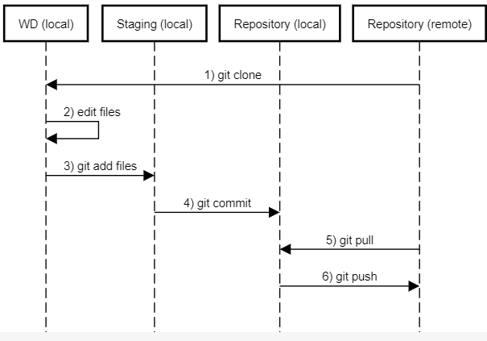
Git workflow
Clone: copy the online repository to our local machine
Add: prepare our edited files for commit
Commit: record a new commit to the repository with our staged files
Pull: pull remote commits into our local repository
Push: push local commits to the remote repository

Slide 13
Workshop 1 – basic Git workflow
https://github.com/jesperstroem/Workshop

Slide 14
Git branches
Branches allow us to manage seperate contained versions of our codebase
They are great for:
Experimenting with new ideas
Fixing bugs
Collaborating with other people
Linking code to a publication
The main idea is that they do not interfere with other branches of the codebase

Slide 15
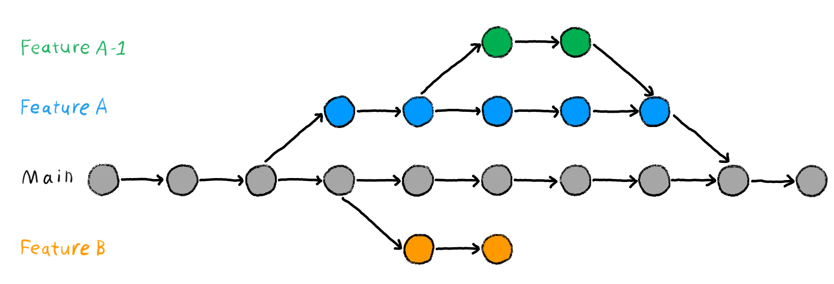
Git branches - features
https://book.the-turing-way.org/reproducible-research/vcs/vcs-git-branches.html

Slide 16

Git branches - collaboration
https://www.nobledesktop.com/learn/git/git-branches

Slide 17
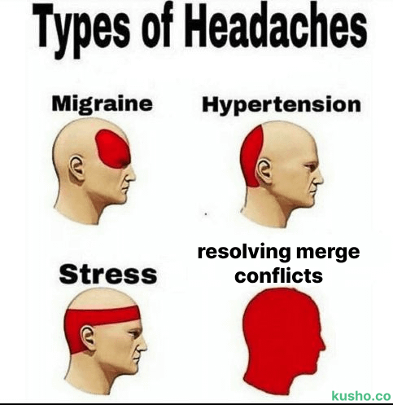
Merge conflicts
Often Git can merge without conflicts
But you are bound to experience a merge conflict at some point
They are the nightmare of every new Git user
But fear not – you will learn how to deal with them!

Slide 18
Workshop 2 – branches & Merges

Slide 19
Git ignore
Git allows us to create a dedicated ”.gitignore” file.
This file tells Git which files to exclude from version control
It is useful in order to not ”pollute” your repository with various irrelevant files
Github has a size limit so sometimes .gitignore is essential!

Slide 20
Workshop 3 – Git ignore

Slide 21
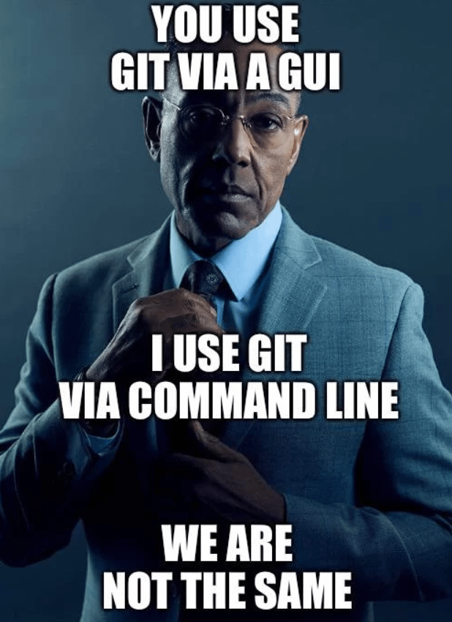
”But this seems really complicated”
Using Git via the command line can be cumbersome
But by learning it this way you get a way better understanding of the underlying process
If you (like me) appreciate a visual approach, there are options to do so

Slide 22
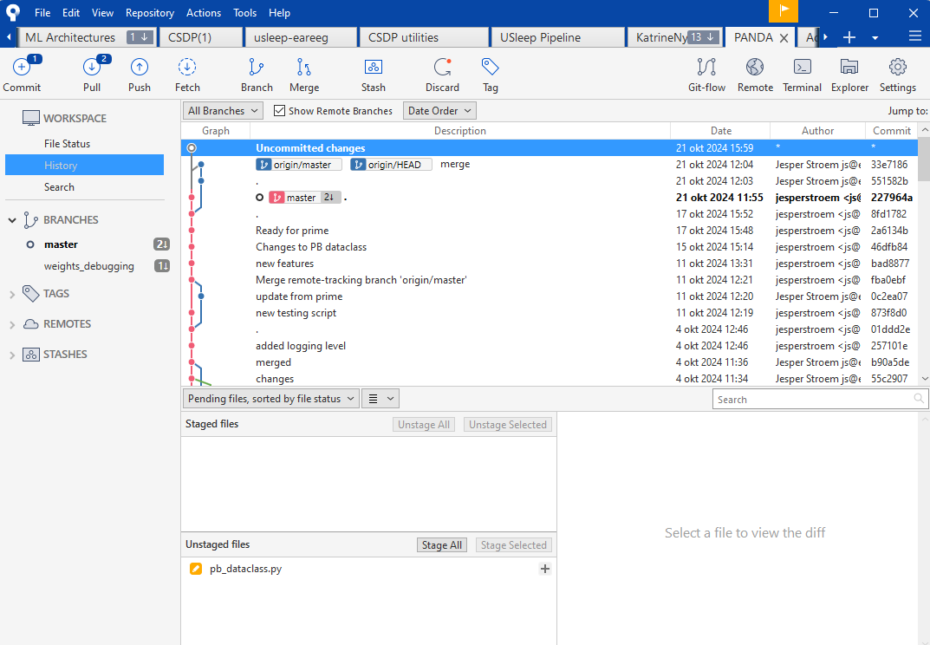
Git User-interfaces to the rescue!
Sourcetree (my preference)
Github Desktop
Visual Studio Code
… and many more

Slide 23
Further reading
https://git-scm.com/docs - official git docs
https://www.w3schools.com/git/ - other workshop tasks for git
https://learngitbranching.js.org/ - visualization tool for branching in git

